Slide 1
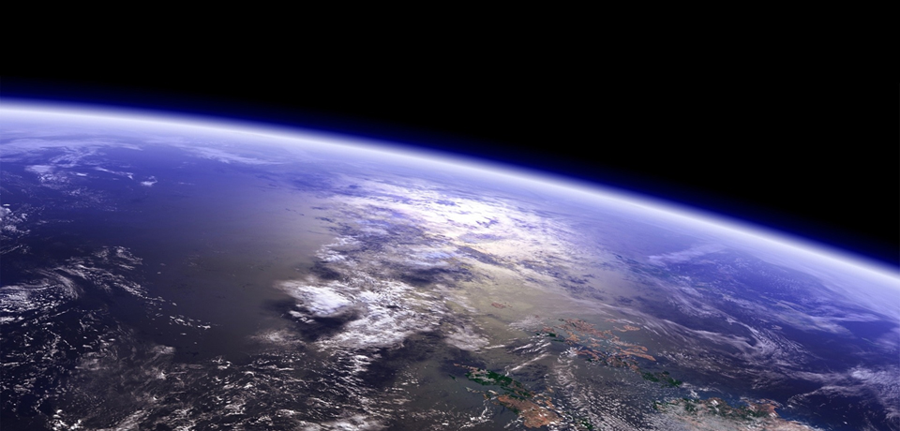
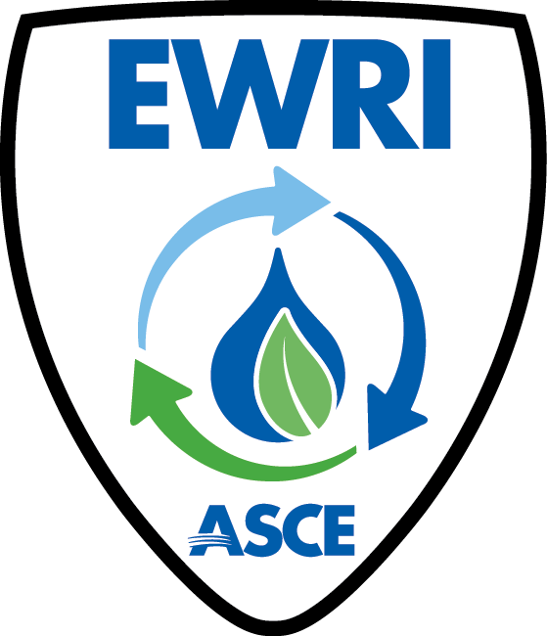
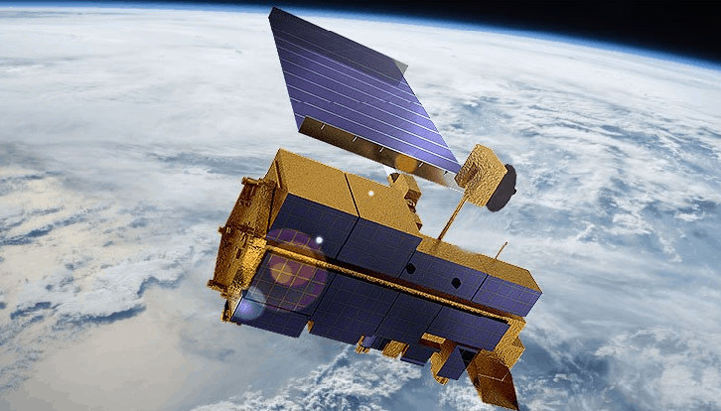
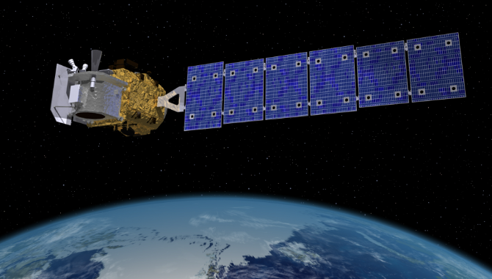
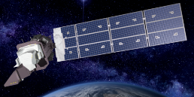
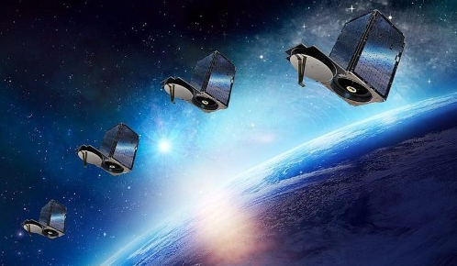
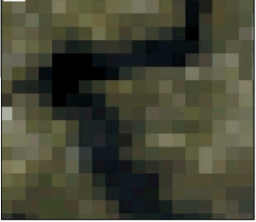
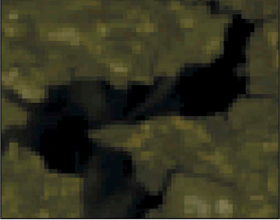
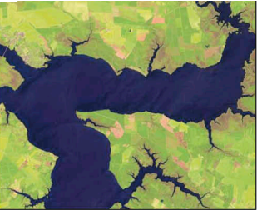
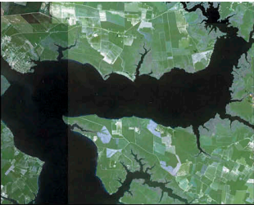

Remote Sensing for Water Resources and Water Quality Modeling Applications Concluding Remarks
Vamsi Krishna Sridharan
May 18, 2025
Anchorage, AK
Notes:
First of all, please pat all of yourselves on the back for staying on until 5 pm on Sunday! Whew… we covered a lot of topics today. This is the third time we have done this workshop, and this time has been the most hands on experience ever! Thank you all. I hope this was informative and enriching. I just want to spend a few minutes putting a lot of what we saw today in the larger global context, to hopefully drive home the point of why remote sensing is so useful for water quality management here in the US, and also globally.

Slide 2
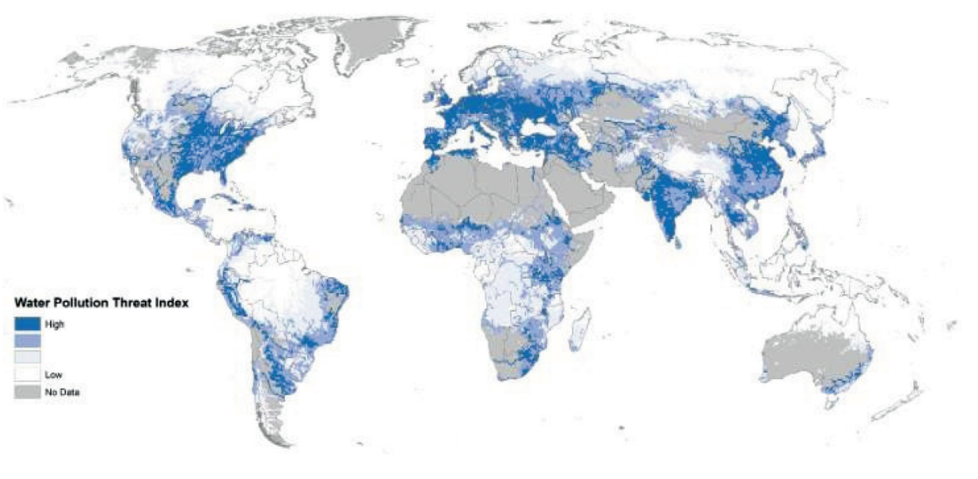
The challenge
Source: Mohanty et al. 2023
Notes:
Worldwide, about 70% of the industrial waste generated is estimated to be dumped untreated into water bodies. Up to 90% of wastewater in developing countries flows untreated into freshwater and coastal waterbodies. It has been estimated that 80% of untreated municipal wastewater including heavy metals, toxic sludge, and 70% agricultural wastes are discharged into water bodies. This map, and maps like this, should that the threat of different kinds of pollution are high and continue to grow in all parts of the world.

Slide 3
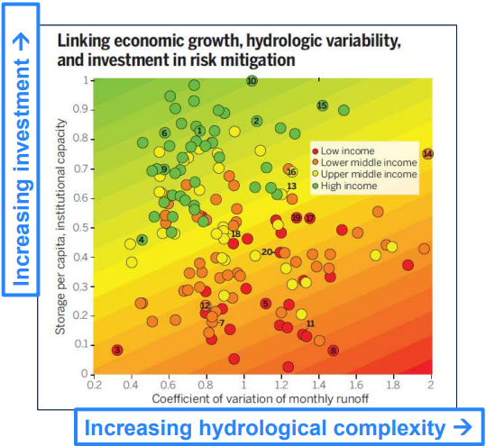
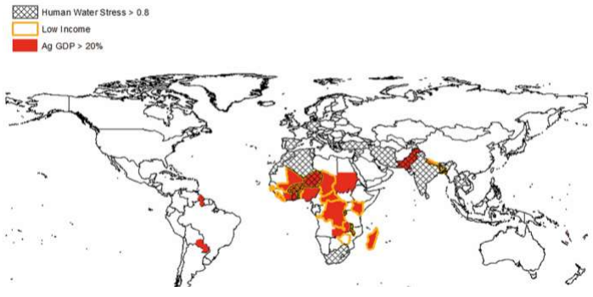
The challenge
Source: Sadoff 2015
Notes:
Econometric data shows a causal linkage between investment (or lack thereof) in managing flow and water quality and economic growth, as seen in the map on the left, and in hydrologic variability and water stress (the heat map on the right).

Slide 4
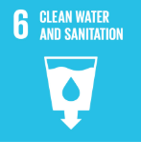








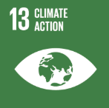
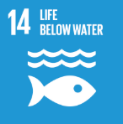

The challenge
Source: https://sdgs.un.org/goals
Notes:
And without proper management of water quality in our waterbodies and coastal oceans, we will be able to meet the grand challenges of this century and beyond. 13 out of the 17 UN Sustainable development goals are inextricably linked to the access to clean and safe drinking water for a variety of purposes. Therefore, there is an urgent need for improved mapping, monitoring, and modeling of our waterbodies. I hope this workshop has shown you how remote sensing, and various software platforms that can ingest and use remote sensing data can be leveraged to help in this.

Slide 5
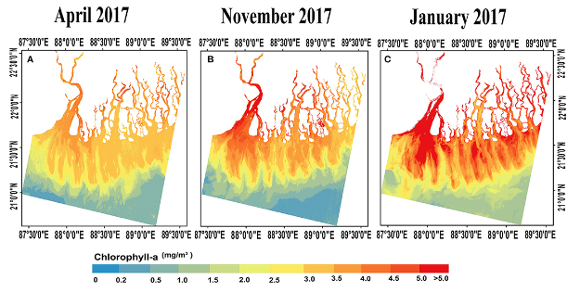
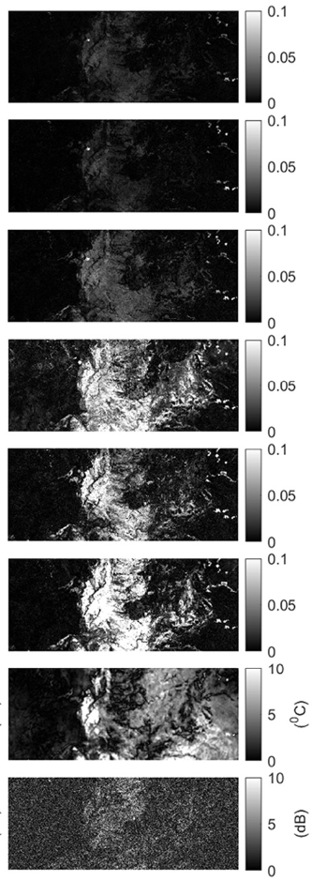
Role of remote sensing in identifying impairment
In water-column impairments
Predicting impairments from land use land cover change
Source: Zhu et al. 2022
Notes:
Remote sensing can be used to measure both what happens on land, and what happens in the water.

Slide 6
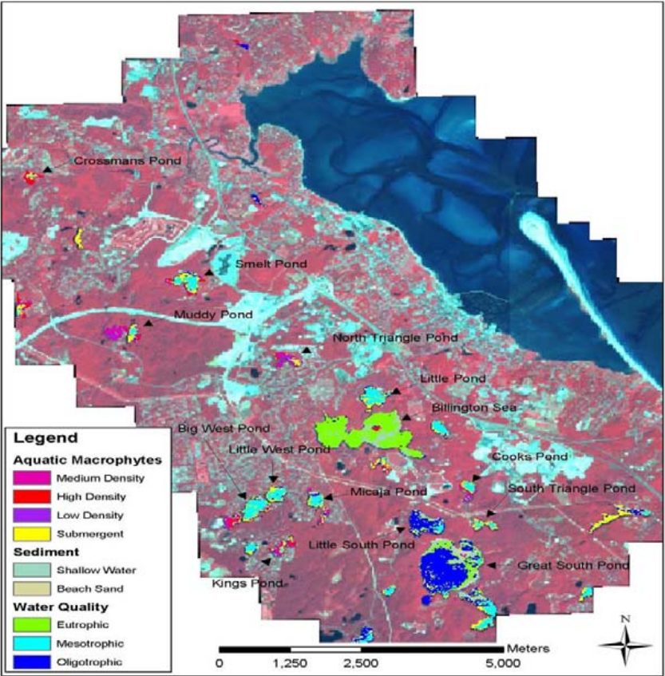
Remote sensing for initial assessment of eutrophication
Source: Rogers and Thompson 2002
Notes:
There are the conventional uses like trying to understand where impairment is occurring

Slide 7
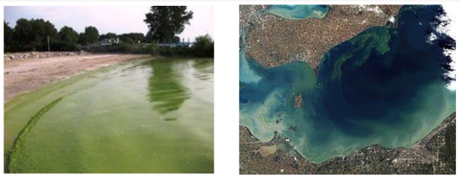
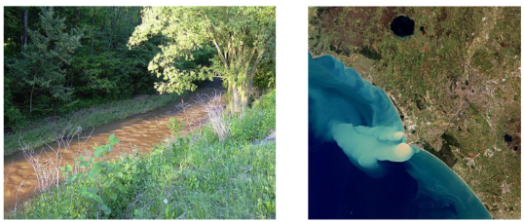
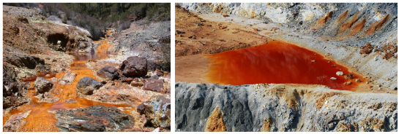
Remote sensing for HABs, acid mine drainage, and sediment plumes
Quantities that affect the water column color
Quantities that have a large spatial footprint
Quantities that persist, or cycle over time
Source: Murray et al. et al. 2022
Notes:
and to what extent it is prevalent. These types of uses require things to be observable in the water column.

Slide 8
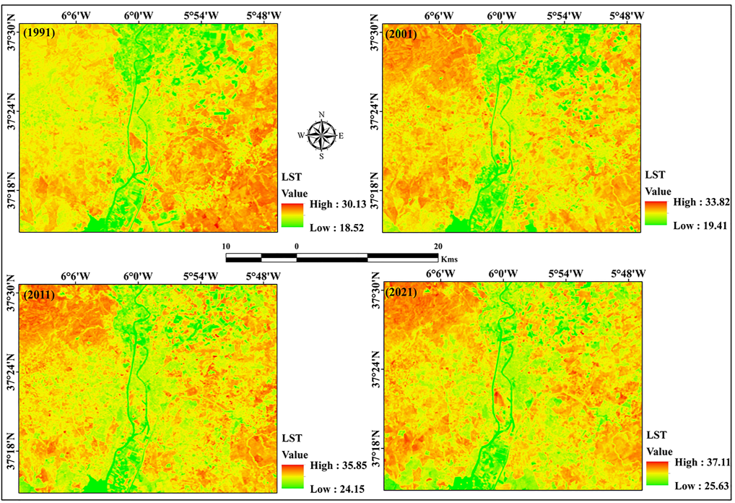
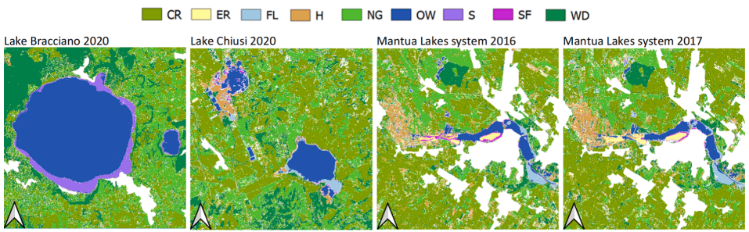
Remote sensing for watersheds
Linking sources to impairments
Urban heat islands and water temperature
Submerged aquatic vegetation and water quality
Sources: Halder et al. 2022;
Piaser and Villa 2023
Notes:
By comparing and analyzing spectral information across multiple reflectance bands, one can come up with indices like the water adjusted vegetation index, the triangular greenness index, and the normalized difference flood index, and other, more complex machine learning and AI-based combinations, that indicate how earth surface processes impact pollution in the water.

Slide 9
Remote sensing preconditions and limitations
Impairment indicator being remotely sensed must be
Consistent with water quality standards
Quantifiable
Sensitive to local conditions
Reproducible
Discriminable at the scale of management
Comparable to in-situ measurements
Able to be referenced to a baseline
Able to indicate a trend
Able to be linked to sources and water conditions
Affordable to acquire
Adapted from: Rogers and Thompson 2002
Notes:
But just because there are applications doesn’t mean that its always straightforward or even the correct tool for the job. Good use of remote sensing is contingent upon several preconditions including water body and impairment characteristics, spatial and temporal resolution of key processes, availability of in-situ data for validating information, and the correct representatability of key physical processes of management interest.

Slide 10
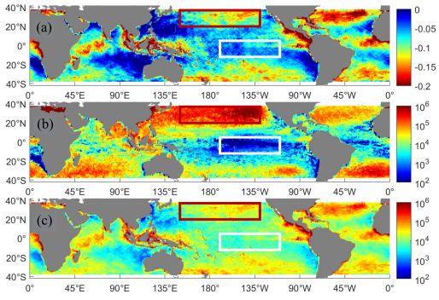
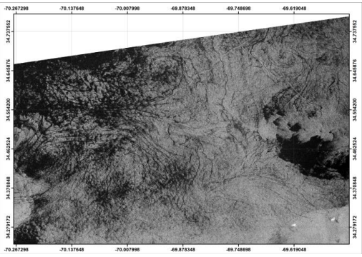
Remote sensing for non-traditional impairments
Microplastics using RADAR wind field and ocean roughness deficit
Microplastics using SAR coupled with striated ocean smoothness, no corresponding shipping, and bacterial activity
Heavy metals using hyperspectral reflectance correlated with environmental factors
Sources: Davaasuren et al. 2018;
Evans and Ruf 2022
Notes:
Finally, I’d like to end by highlighting certain exciting new areas of nonconventional application. By coupling sea surface reflectance and diffusion characteristics, vis-à-vis roughness to other environmental variables, researchers have been able to link hitherto undetectable pollutants such as microplastics and heavy metals in the open ocean. This is very exciting and points to innovative ways of applying remote sensing for detecting PFAS, bioenzymes, and other emergent contaminants in the near future.

Slide 11
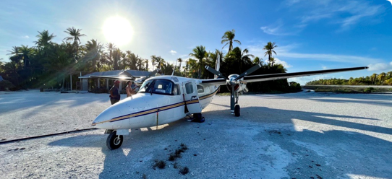
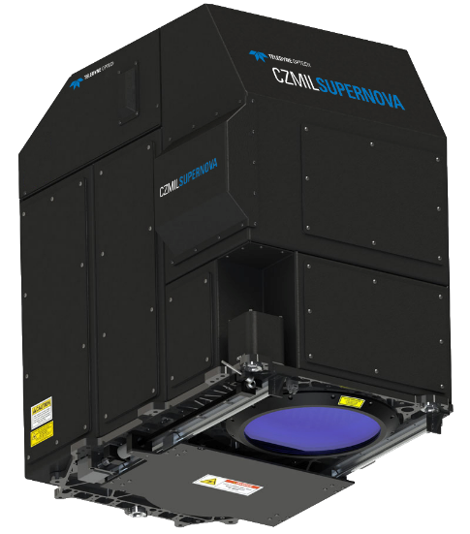
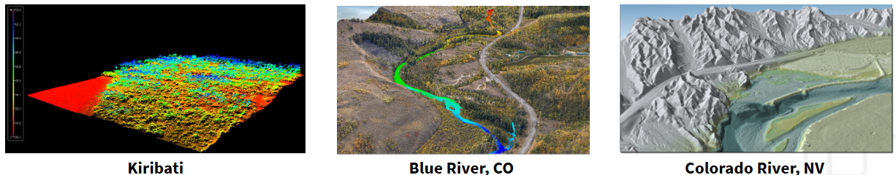
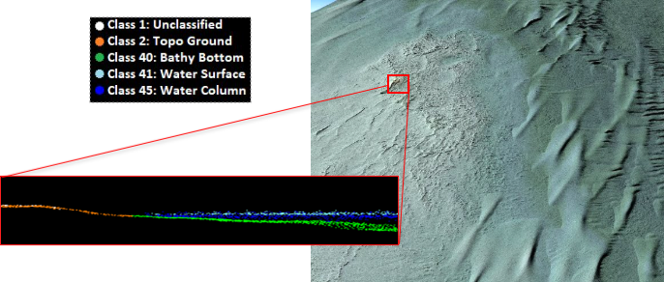
Remote sensing for coupled topobathymetry, and terrestrial ecosystem and benthic substrate mapping
Coastal
Zone
Mapping
Imaging
Lidar
SuperNova
Notes:
Another super-exciting application which we are using today at Tetra Tech is dual spectrum LiDAR for mapping both the topography and bathymetry, as well as terrestrial habitats and benthic substrates in waters up to 45 m deep. We are able to do this by using both 1,064 nm laser light to obtain surface returns, and 532 nm light to penetrate the water column simultaneously. We’ve been able to map 100s to 1000s of square kilometers with a single flight plan in various parts of the world including the great lakes, Colorado, and the coastal ocean off of Kiribati. Such mapping provides extremely useful information that can be used in water quality modeling.

Slide 12
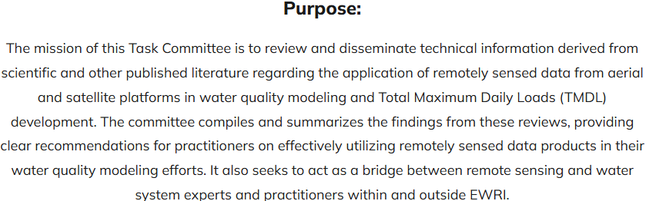
Remote Sensing Applications for TMDL Modeling Task Committee
Saurav Kumar, Ph.D., P.E., F.EWRI, M.ASCE
Omar I. Abdul-Aziz, Ph.D., EIT, A.M.ASCE
Huilin Gao, Aff.M.ASCE
Abhinav Gupta, Ph.D.
Christine Lee, Ph.D.
Walter McDonald, Ph.D.
Santosh S. Plamate, Ph.D.
Abhiram S.P. Pamula, Ph.D.
Nigel W.T. Quinn, Ph.D., P.E., B.C.WRE(Ret.), F.EWRI, F.ASCE
John J. Ramirez-Avila, Ph.D., H.G. Ing., P.H., F..EWRI, M.ASCE
Vamsi K. Sridharan, Ph.D., M.ASCE
Rocky Talchabhadel, Ph.D.
Min-Cheng Tu
Erin Urquhart
William J. Weiss, Ph.D., P.E., B.C.WRE, M.ASCE
Qing Qang, Ph.D.
https://www.asce.org/communities/institutes-and-technical-groups/environmental-and-water-resources-institute/committees/environmental-and-water-resources-institute/ewri-governing-board/technical-coordination-executive-committee/watershed-council/watershed-management-technical-committee/remote-sensing-applications-for-tmdl-modeling
Vamsi Krishna Sridharan, PhD, M.ASCE Innovative Solutions Lead
Direct +1 (650) 862-2658 vamsi.sridharan@tetratech.com Tetra Tech | Leading with Science®
Water Division
10306 Eaton Place | Fairfax, VA 22030 https://www.tetratech.com
Notes:
And with that, from the remote sensing task committee team, I’d like to say a big thank you. If you’d like to be a part of the exciting work we do, please do reach out to us with your CV, and a very brief statement of interest. We’re always looking for dynamic minds to advance the science and push the implementation needle.

